Slide 1
UC Berkeley’s CS61A – Lecture 03 – Control
Will robots take your job? Quarter of US workers at risk https://www.apnews.com/6034c9ce1af347ec8da996e39b29c51b
“The Brookings Institution has calculated that about 36 million Americans hold jobs with "high exposure" to automation, meaning at least 70% of their tasks could be performed by machines using current technology. Professions most likely to be impacted by automation include food-service jobs like cooks and waiters, short-haul truck drivers, and office clerks. According to Brookings' Mark Muro, this transition could happen in "a few years or...two decades," but it would be hastened by an economic downturn. Most U.S. workers are expected to adapt to this shift without losing their jobs, but younger, rural employees likely will be affected most profoundly. The report predicts the professions least likely to be affected by automation will be those requiring not only higher educational experience, but also interpersonal skills and emotional intelligence.”

Slide 2
Announcements
Lab & office hours start this week
Extra lectures (optional, on Additional Topics) start this week, Wednesdays 1-2pm in Soda 310
HW 01 is released an is due this Thursday
Hog project will be released soon

Slide 3
Print and None
(Demo1)

Slide 4
None Indicates that Nothing is Returned
The special value None represents nothing in Python
A function that does not explicitly return a value will return None
Careful: None is not displayed by the interpreter as the value of an expression
>>> def does_not_return_square(x):
... x * x
...
>>> does_not_return_square(4)
>>> sixteen = does_not_return_square(4)
>>> sixteen + 4
Traceback (most recent call last):
File "<stdin>", line 1, in <module>
TypeError: unsupported operand type(s) for +: 'NoneType' and 'int'
No return
None value is not displayed
The name sixteen is now bound to the value None

Slide 5
Pure Functions & Non-Pure Functions
Return value
Pure Functions
just return values
-2
abs
2
Argument
2, 100
pow
1267650600228229401496703205376
2 Arguments
Returns None!
Non-Pure Functions
have side effects
-2
print
None
A side effect isn't a value; it's anything that happens as a consequence of calling a function
Python displays the output “-2”

Slide 6
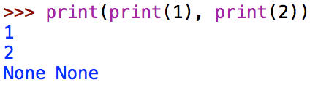
Nested Expressions with Print
None, None
print(...):
Does not get displayed
None
display “None None”
None
print(print(1), print(2))
func print(...)
None
None
print(1)
print(2)
func print(...)
1
func print(...)
2
1
print(...):
2
print(...):
None
None
display “1”
display “2”

Slide 7
Multiple Environments

Slide 8
Life Cycle of a User-Defined Function
Formal parameter
What happens?
Return expression
Def statement:
Name
A new function is created!
>>> def
square( x ):
Def statement
return mul(x, x)
Name bound to that function in the current frame
Body
(return statement)
operand: 2+2
argument: 4
Operator & operands evaluated
Call expression:
square(2+2)
Function (value of operator) called on arguments (values of operands)
operator: square
function: func square(x)
A new frame is created!
Calling/Applying:
4
square( x ):
Argument
Signature
Parameters bound to arguments
16
Return value
Body is executed in that new
environment

Slide 9
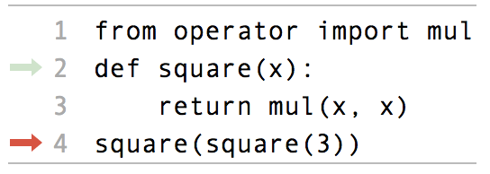
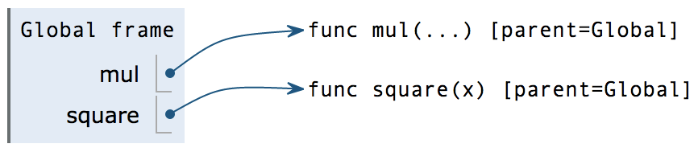
Multiple Environments in One Diagram!
square(square(3))
func square(x)
square(3)
func square(x)
3
http://pythontutor.com/composingprograms.html#code=from%20operator%20import%20mul%0Adef%20square%28x%29%3A%0A%20%20%20%20return%20mul%28x,%20x%29%0Asquare%28square%283%29%29&cumulative=true&curInstr=0&mode=display&origin=composingprograms.js&py=3&rawInputLstJSON=%5B%5D

Slide 10
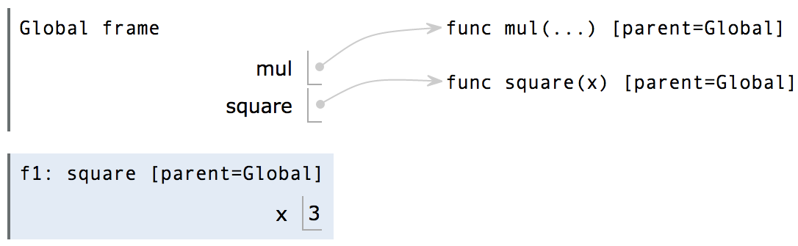
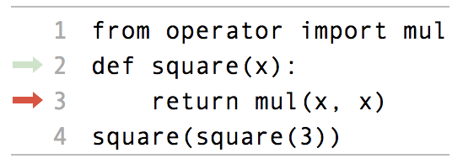
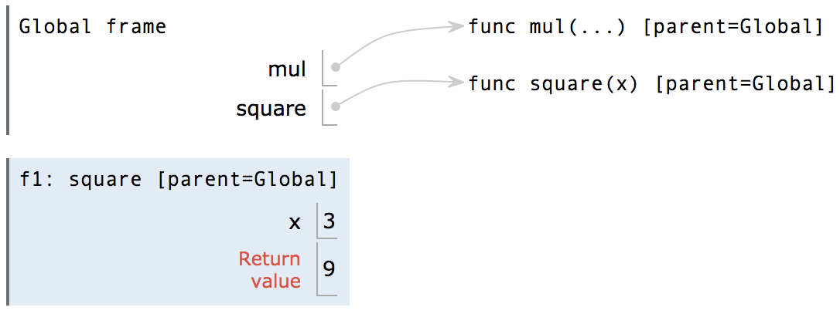
Multiple Environments in One Diagram!
square(square(3))
func square(x)
9
square(3)
func square(x)
3
http://pythontutor.com/composingprograms.html#code=from%20operator%20import%20mul%0Adef%20square%28x%29%3A%0A%20%20%20%20return%20mul%28x,%20x%29%0Asquare%28square%283%29%29&cumulative=true&curInstr=0&mode=display&origin=composingprograms.js&py=3&rawInputLstJSON=%5B%5D

Slide 11
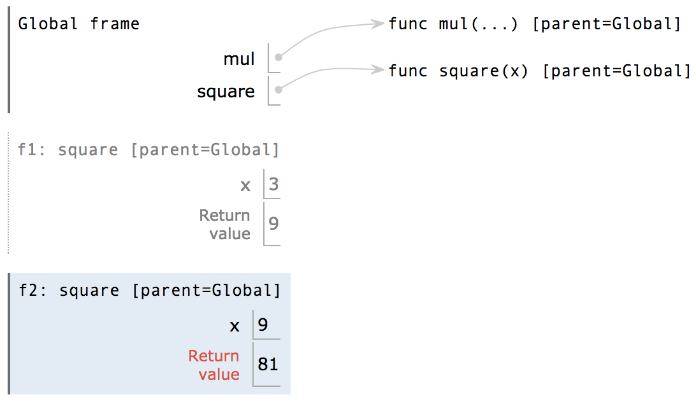
Multiple Environments in One Diagram!
1
2
2
1
1
81
square(square(3))
func square(x)
9
square(3)
An environment is a sequence of frames.
The global frame alone
A local, then the global frame
func square(x)
3
http://pythontutor.com/composingprograms.html#code=from%20operator%20import%20mul%0Adef%20square%28x%29%3A%0A%20%20%20%20return%20mul%28x,%20x%29%0Asquare%28square%283%29%29&cumulative=true&curInstr=0&mode=display&origin=composingprograms.js&py=3&rawInputLstJSON=%5B%5D

Slide 12
Names Have No Meaning Without Environments
1
2
2
1
1
Every expression is evaluated in the context of an environment.
A name evaluates to the value bound to that name in the earliest frame of the current environment in which that name is found.
An environment is a sequence of frames.
The global frame alone
A local, then the global frame
http://pythontutor.com/composingprograms.html#code=from%20operator%20import%20mul%0Adef%20square%28x%29%3A%0A%20%20%20%20return%20mul%28x,%20x%29%0Asquare%28square%283%29%29&cumulative=true&curInstr=0&mode=display&origin=composingprograms.js&py=3&rawInputLstJSON=%5B%5D

Slide 13
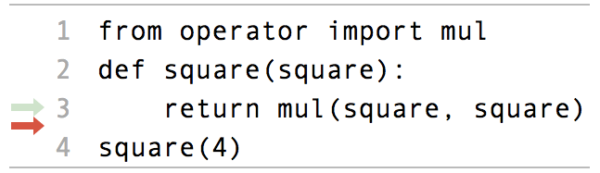
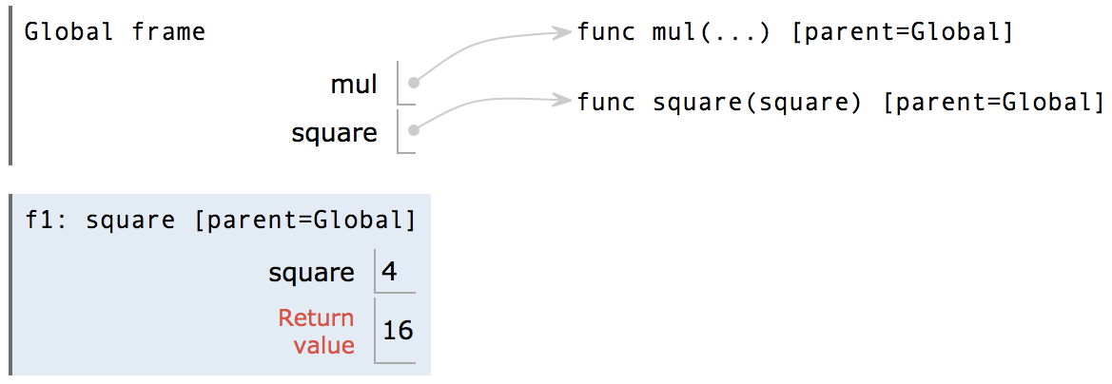
Names Have Different Meanings in Different Environments
A call expression and the body of the function being called
are evaluated in different environments
1
2
1
Every expression is evaluated in the context of an environment.
A name evaluates to the value bound to that name in the earliest frame of the current environment in which that name is found.
http://pythontutor.com/composingprograms.html#code=from%20operator%20import%20mul%0Adef%20square%28square%29%3A%0A%20%20%20%20return%20mul%28square,%20square%29%0Asquare%284%29&cumulative=true&curInstr=0&mode=display&origin=composingprograms.js&py=3&rawInputLstJSON=%5B%5D

Slide 14
Miscellaneous Python Features
Division
Multiple Return Values
Source Files
Doctests
Default Arguments
(Demo2)

Slide 15
Conditional Statements

Slide 16
Statements
A statement is executed by the interpreter to perform an action
Compound statements:
Statement
The first header determines a statement’s type
Clause
<header>:
<statement>
<statement>
...
<separating header>:
<statement>
<statement>
...
...
The header of a clause “controls” the suite that follows
Suite
def statements are compound statements

Slide 17
Compound Statements
Compound statements:
<header>:
<statement>
<statement>
...
<separating header>:
<statement>
<statement>
...
...
A suite is a sequence of statements
Suite
To “execute” a suite means to execute its sequence of statements, in order
Execution Rule for a sequence of statements:
Execute the first statement
Unless directed otherwise, execute the rest

Slide 18
Conditional Statements
(Demo3)
def my_abs(x):
"""Return the absolute value of x."""
if x < 0:
return -x
elif x == 0:
return 0
else:
return x
1 statement,
3 clauses, 3 headers,
3 suites
Execution Rule for Conditional Statements:
Syntax Tips:
Each clause is considered in order.
Evaluate the header's expression.
If it is a true value, execute the suite & skip the remaining clauses.
Always starts with "if" clause.
Zero or more "elif" clauses.
Zero or one "else" clause, always at the end.

Slide 19
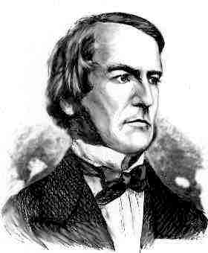
Boolean Contexts
def my_abs(x):
"""Return the absolute value of x."""
if x < 0:
return -x
elif x == 0:
return 0
else:
return x
Two boolean contexts
George Boole
False values in Python:
False, 0, '', None
(more to come)
True values in Python:
Anything else (True)
Read Section 1.5.4!
Reading: http://composingprograms.com/pages/15-control.html#conditional-statements

Slide 20
Iteration

Slide 21
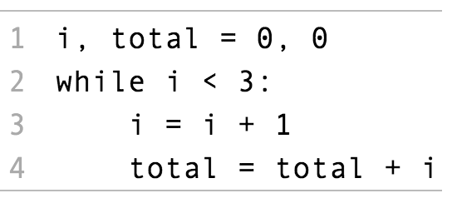
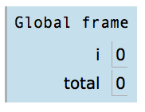
Iteration: While Statements
(Demo4)
1
2
3
1
3
6
Execution Rule for While Statements:
George Boole
1. Evaluate the header’s expression.
2. If it is a true value, execute the (whole) suite, then return to step 1.

